Slide 1
Control Statements in Java

Slide 2
Control Statements
A java statement is the smallest unit that is a complete instruction in itself.
Statements in java generally contain expressions and end a with semi colon.
The two most commonly used statements in any programming language:
Sequential statements: executed one by one.
Control statements : Executed randomly and repeatedly.

Slide 3
System.out.println(“Hello”);
x=y+z
System.out.println(x);
These statements are executed by JVM one by one in sequential manner.
These are used to write simple programs.
To write better and complex programs, we need better control on the flow of execution.

Slide 4
Interview Questions
What are control statements?
Control statements are the statements which alter the flow of execution and provide better control to the programmer on the flow of execution.
They are useful to write better and complex programs.

Slide 5
Control Statements
if…else statement
do…while loop
while loop
for loop
for-each loop
switch statement
break statement
continue statement
return statement

Slide 6
if…else
if- else statement can be written in the following different variations:
If(condition1)
Statement 1;
else if(condition2)
statements2;
else if(condition3)
statements 3;
else statements4;
Here, if condition1 is true, then statement1 is executed, if condition1 is false, then condition2 is tested. If condition2 is true, then statements2 is executed, other condition 3 is tested.

Slide 7
if…. else
if(condition1)
if(condition2)
if(condition3)
statement1;
else statement2;
else statement3;
else statement 4;
If condition1 is true, then condition2 is tested
if condition2 is also true then condition 3 is tested,
if condition3 is true then statement1 will be executed.
If condition 3 is false then statement2 will executed.
If condition2 is false then statement 3 will be executed.
If condition1 is false then statement4 will be executed.

Slide 8
While loop
A while loop statement in Java programming language repeatedly executes a target statement as long as a given condition is true.
Syntax
The syntax of a while loop is −
while(Boolean_expression) { // Statements}
When executing, if the boolean_expression result is true, then the actions inside the loop will be executed. This will continue as long as the expression result is true.
When the condition becomes false, program control passes to the line immediately following the loop.

Slide 9
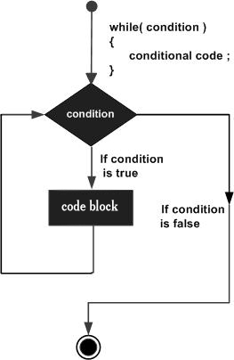
Flow diagram

Slide 10
do….while
A do...while loop is similar to a while loop, except that a do...while loop is guaranteed to execute at least one time.
Syntax
Following is the syntax of a do...while loop −
do { // Statements }while(Boolean_expression);
Notice that the Boolean expression appears at the end of the loop, so the statements in the loop execute once before the Boolean is tested.
If the Boolean expression is true, the control jumps back up to do statement, and the statements in the loop execute again. This process repeats until the Boolean expression is false.

Slide 11
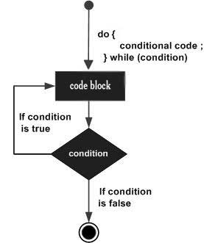
Flow diagram

Slide 12
Interview Question
Out of do…while and while– which loop is efficient?
In a do..while loop, the statements are executed without testing the condition, the first time. For second time only the condition is observed. This means that the programmer does not have a control right from the beginning of its execution.
In a while loop, the condition is tested first and then only the statements are executed. This means it provides better control right from the beginning. Hence, while loop is more efficient than do… while loop.

Slide 13
For loop
A for loop is a repetition control structure that allows you to efficiently write a loop that needs to be executed a specific number of times.
A for loop is useful when you know how many times a task is to be repeated.
Syntax
The syntax of a for loop is −
for(initialization; Boolean_expression; update) { // Statements } Here is the flow of control in a for loop −
The initialization step is executed first, and only once. This step allows you to declare and initialize any loop control variables and this step ends with a semi colon (;).
Next, the Boolean expression is evaluated. If it is true, the body of the loop is executed. If it is false, the body of the loop will not be executed and control jumps to the next statement past the for loop.
After the body of the for loop gets executed, the control jumps back up to the update statement. This statement allows you to update any loop control variables. This statement can be left blank with a semicolon at the end.
The Boolean expression is now evaluated again. If it is true, the loop executes and the process repeats (body of loop, then update step, then Boolean expression). After the Boolean expression is false, the for loop terminates.

Slide 14
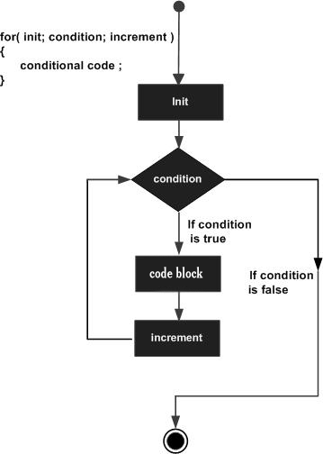
Flow Diagram

Slide 15
for-each loop
it starts with the keyword for like a normal for-loop.
Instead of declaring and initializing a loop counter variable, you declare a variable that is the same type as the base type of the array, followed by a colon, which is then followed by the array name.
In the loop body, you can use the loop variable you created rather than using an indexed array element.
It’s commonly used to iterate over an array or a Collections class (eg, ArrayList)

Slide 16
Syntax:
for (type var : array)
{ statements using var; }
is equivalent to:
for (int i=0; i<arr.length; i++)
{
type var = arr[i];
statements using var;
}

Slide 17
Interview questions
What is a collection?
A collection represents a group of elements like integer values or objects. Examples for collections are arrays and java.util classes(stack, Linked List, Vector) etc.

Slide 18
Example
class ForEachExample{
public static void main(String args[]){
//declaring an array
int arr[]={12,13,14,44};
//traversing the array with for-each loop
for(int i:arr){
System.out.println(i);
}
}
}

Slide 19
Switch case
A switch statement allows a variable to be tested for equality against a list of values. Each value is called a case, and the variable being switched on is checked for each case.
Syntax
The syntax of enhanced for loop is −
switch(expression) {
case value :
// Statements
break; // optional
case value :
// Statements
break; // optional
// You can have any number of case statements.
default : // Optional
// Statements
}

Slide 20
Rules
The following rules apply to a switch statement −
The variable used in a switch statement can only be integers, convertable integers (byte, short, char), strings and enums.
You can have any number of case statements within a switch. Each case is followed by the value to be compared to and a colon.
The value for a case must be the same data type as the variable in the switch and it must be a constant or a literal.
When the variable being switched on is equal to a case, the statements following that case will execute until a break statement is reached.
When a break statement is reached, the switch terminates, and the flow of control jumps to the next line following the switch statement.
Not every case needs to contain a break. If no break appears, the flow of control will fall through to subsequent cases until a break is reached.
A switch statement can have an optional default case, which should appear at the end of the switch. The default case can be used for performing a task when none of the cases is true. No break is needed in the default case.

Slide 21
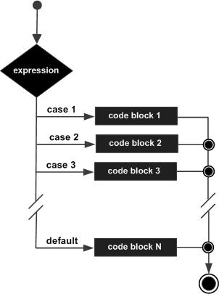
Flow diagrams

Slide 22
Break and continue
Used inside a loop to come out of it.
Used inside the switch block to come out of switch block.
Continue is used inside a loop to repeat the next iteration of the loop. When continue is executed the subsequent statements in the loop are not executed and control of execution goes back to the next repetition of loop.

Slide 23
Example
package com.ravi2.org;
public class ContinueExample {
//Java Program to demonstrate the use of continue statement
//inside the for loop.
public static void main(String[] args) {
//for loop
for(int i=1;i<=10;i++){
if(i==5){
//using continue statement
continue;//it will skip the rest statement
}
System.out.println(i);
}
}
}

Slide 24
Return statement
return statement is used in a method to come out of it to the calling method.
Ex we are calling a method by name myMethod() from main method.
If return is used inside the myMethod() then the flow of execution comes of it and goes back to the main().
Return also returns some values to main method.
return 1;
return x;
return (x+y)

Slide 25
In the following example
We have taken a method myMethod() accepts integer value. Calculates the square value and returns it to the main method.
Demo.myMethod(10)
We are not using an object to call the method since it is a static method.
Classname.methodname()
Demo.myMethod(10)
We need to receive the result returned from method.
int res=Demo.myMethod(10)

Slide 26
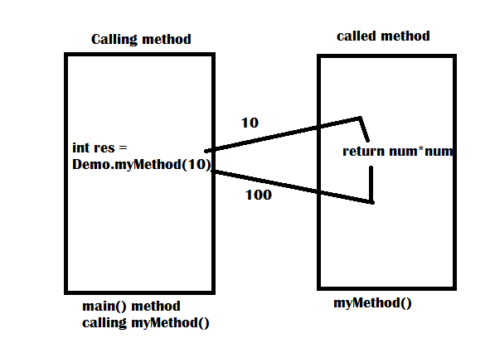
myMethod()
static int myMethod(int num)
{ return num*num;
}

Slide 27
program
package com.ravi2.org;
//calling a method and returning the result from the method
public class Demo {
public static void main(String[] args) {
// TODO Auto-generated method stub
// call myMethod() catch teh result in res
// since myMethod() is static, we can call it using classname.methodname.
int res=Demo.myMethod(10);
//display result
System.out.println("Result="+res);
}
static int myMethod(int num)
{
return num*num;
}
}

Slide 28
Exit(0)
import java.util.*;
import java.lang.*;
class GfG
{
public static void main(String[] args)
{
int arr[] = {1, 2, 3, 4, 5, 6, 7, 8};
for (int i = 0; i < arr.length; i++)
{
if (arr[i] >= 5)
{
System.out.println("exit...");
// Terminate JVM
System.exit(0);
}
else
System.out.println("arr["+i+"] = " +
arr[i]);
}
System.out.println("End of Program");
}
}

Slide 29
Interview question
What is the difference between return and System.exit(0)?
return statement is used inside a method to come out of it.
System.exit(0) is used in any method to come out of the program.
→ what is the difference between System.exit(0) and System.exit(1)?
System.exit(0) terminates the program normally, whereas System.exit(1) teminates the program because of some error encountered in the program.

